Slide 1

Classifying CIFAR -10 Image Using CNN
Macarena Cabrales
Notes:
Good afternoon. Today, I would like to present the project that I have been working on the last past weeks about CNN, which in otherwords "A CNN is a special kind of computer program designed to look at images and learn from them, just like our eyes and brain do." This kind of image recognition technology is used in things like self-driving cars (to spot pedestrians), medical diagnosis (to detect diseases from images), and smartphone cameras (to recognize faces or objects)." The goal of this project is to build a Convolutional Neural Network (CNN) model to classify images from the dataset, in this case I have used CIFAR-10 into predefined categories/classes.

Slide 2



CONTENT
Data Processing
Model Architecture
Model Training
Model Evaluation
Transfer Learning
Model Deployment
Notes:
Data processing and Model architecture to prepare the data and design our CNN model
Then we´ll proceed with Model Training and Model Evaluation, which is the big piece of the project where we´ll train our model using different optimization techniques and evaluate its performance
Lastly, Transfer learning and Model deployment. Where we leverage the pre-trained model to improve performance,

Slide 3
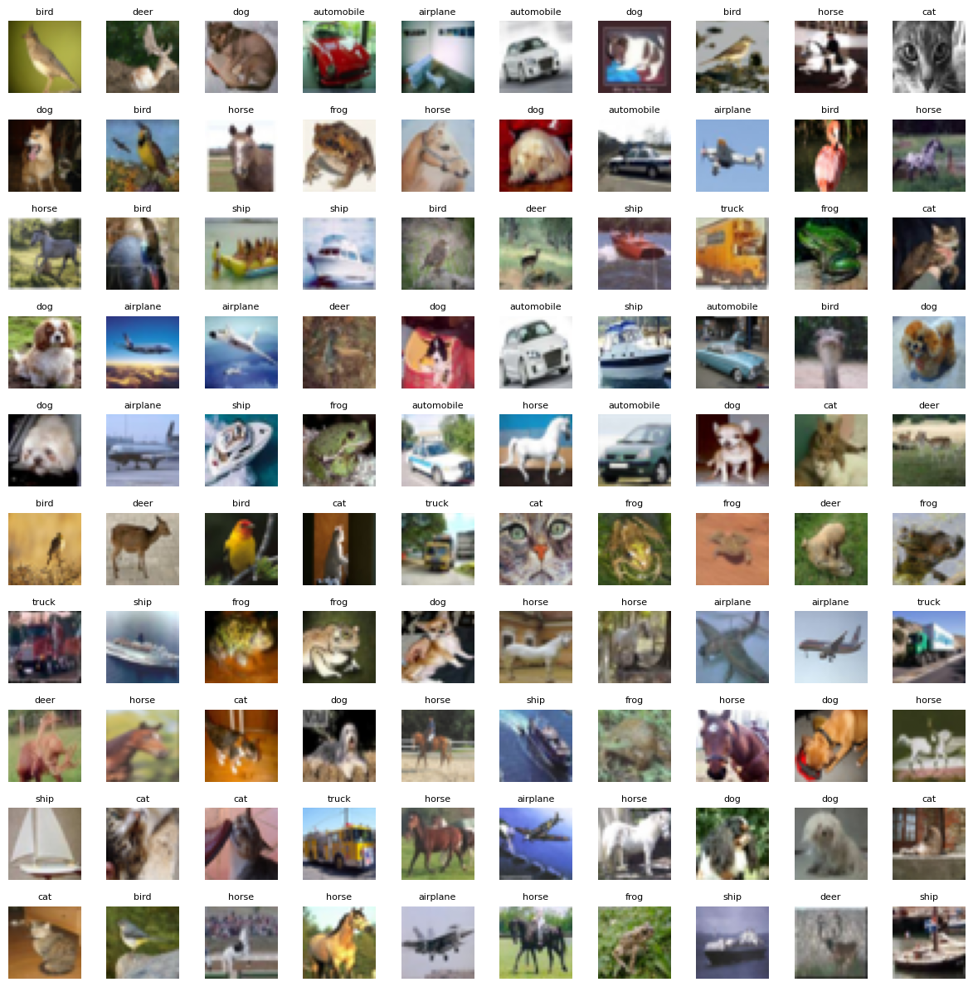
Data Processing
Data Used: CIFAR-10
Data composed of: 60k color images 32X32 in 10 classes.
Steps Taken:
🗂️ Load the data files: Split the files in 5 batch folders
🧩 Reshape the images:
images = images.reshape((len(images), 3, 32, 32)).transpose(0, 2, 3, 1)
🏷️ Organize the labels: Each image will be assigned to a label
🧠 Return training and test data:
Training set: (train_images) (train_labels)
Test set: (test_images) (test_labels)
Notes:
Data Processing is first step I have taken in this project to first understand what type of structure data we´ll use in the dataset. Think that the data comes in a format that the computer can´t directly learn from, therefore, It´s important to reshape, clean and label the data so that the computer understands: This is a cat, this picture of a truck. In this project I have used CIFAR-10 dataset, which contains 60k small color pictures across 10 categories like airplanes, cars, dogs etc. These images are stored in a format that´s not ready for learning.
Therefore, throughout this process, I have done: 1) Loading the data file and the path directory. We splitted 5 folders of images. This way my code goes into each one and pulls out the images and their labels (like this is a frog, a cat etc) 2) Reshape the image: The pictures that are originally stored are long row of numbers (not real images yet). My code rearranges those numbers into real 32 x32 pixel images with the color channels (red, green, blue)
3) Organize the labels: Each image needs a label - something that tells the computer what´s it´s looking at. So my code gathers those too and pairs them with the right image.
4) Returns training data set: Then we obtain 2 organized data set. a) training set (used to teach the computer) and test set( to check if it´s learning correctly)

Slide 4
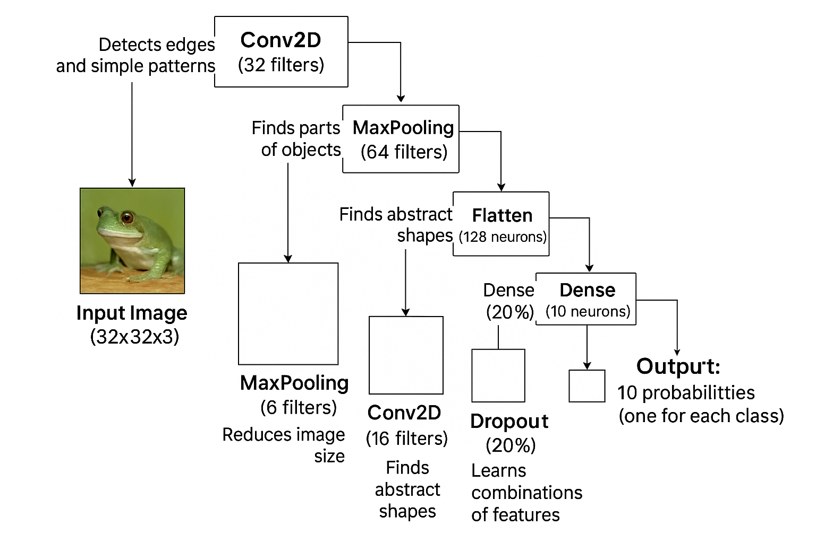
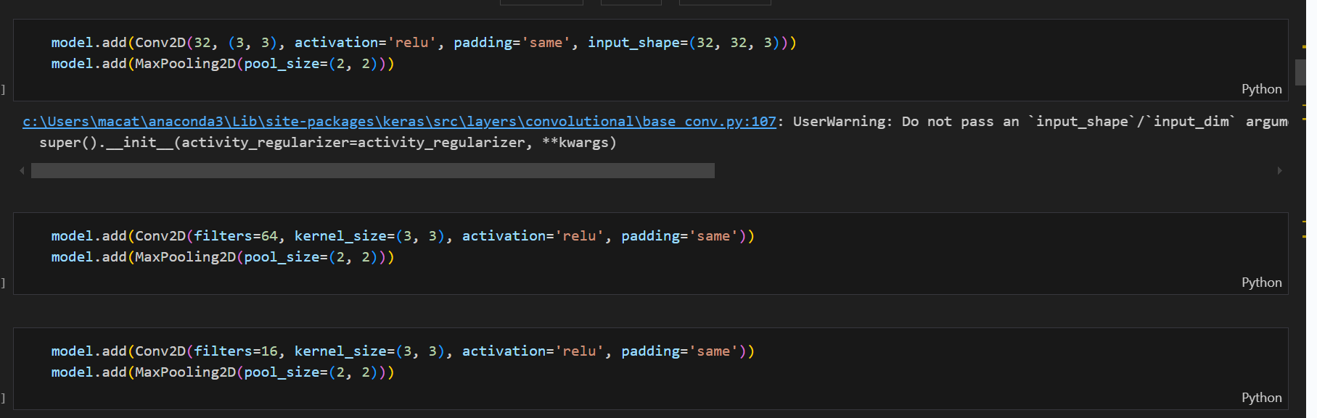
Model Architecture
Steps Taken:
🧱 First, it scans the image for basic features
🧠 Iit makes a decision
🔁 We flatten the image into a list of numbers
🎯 Finally, it gives us a prediction
🧠 Then it looks for more complex features
Notes:
Model Architecture is the blueprint of how our AI brain is built. It's A layered structure that takes an image, processes it ste by step, and then makes a prediction. Like I´m 95% sure this is a cat. Each layer helps the model see, extract pattern and decide what image is. For that we use Convolutional Neural Network (especially good at understanding images)
My CNN Architecture: 1) Scans the image for basic features: Using tiny filters, the model looks for thinks like edges, lines, simple shapes. This happens thanks to 👉 Convolution (detecting patterns), 👉 Pooling (keeping only the strongest signals).
2) Then it looks for more complex features: As the image passes through more layers, the model begins to recognized more meaningful parts like wheels, wings, faces.
3) We flatten the image into a list of numbers: At this point, the model has extracted all the important features and is ready to make sense of them.
4) Now the CNN makes a decision: A full connected neural layer combines everything it has seen to decide what image might be. I also included the step, called “dropout” to make sure the model doesn´t get too confident.
5) Finally, gives us a prediction: Last layer gives us 10 possible answers. One for each category in the CIFAR-10 dataset. Ex: 85% likely to be a cat, 10& a dog and 5% a horse.
Code Explanation:
activation='relu' → adds non-linearity, helps it learn complex patterns.
padding='same' → keeps the image size unchanged after filtering.
64 filters — more filters = the ability to detect more complex shapes.
softmax turns outputs into probabilities (like: 70% cat, 20% dog...)
Dense: Learns patterns from features

Slide 5
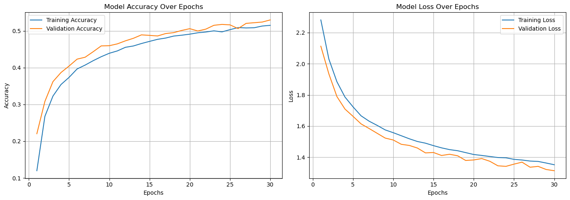
Model Training
30 Epoch
Steps Taken & Output:
🔧 Compile the Model
Optimization technique: “Adam”. This algorithm works well for image problems
Applying early stopping; if the model does not improve after 5 epoch
🏃‍♂️ Train the Model
We can see that training accuracy increase from 40% to 80% across 14 epochs.
Concluding that the model is generalizating well.
Notes:
Model Training: Training is the process where we teach the model how to recognized images by showing it thousands of examples.
Is to Compiling the model: With that we tell the model how to learn and how to judge it´s own progress. One aspect that I have added on my code when doing this part is the “early stopping function” to ensure the training stops if it doesnt improve for 5 epoch, this way it was taking me less time. Because one of the challenges I had in the project was time consuming of loading the training model to proceed with the exercise.
Training the Model: with “model fit”, At first I started with 60 epoch and I lowered down to 30 epoch.
Saved the model.
We can see that training accuracy steadily increased from 40% to 80% across 14th epoch. This is great as we want to have higher training accuracy vs validation accuracy. This means is generalizating well the model.
train_images → the images the model learns from
train_labels → the correct answers, turned into one-hot vectors via to_categorical()
Accuracy tells us how often the model guesses correctly.
Loss tells us how confident and correct the model is — lower is better.

Slide 6
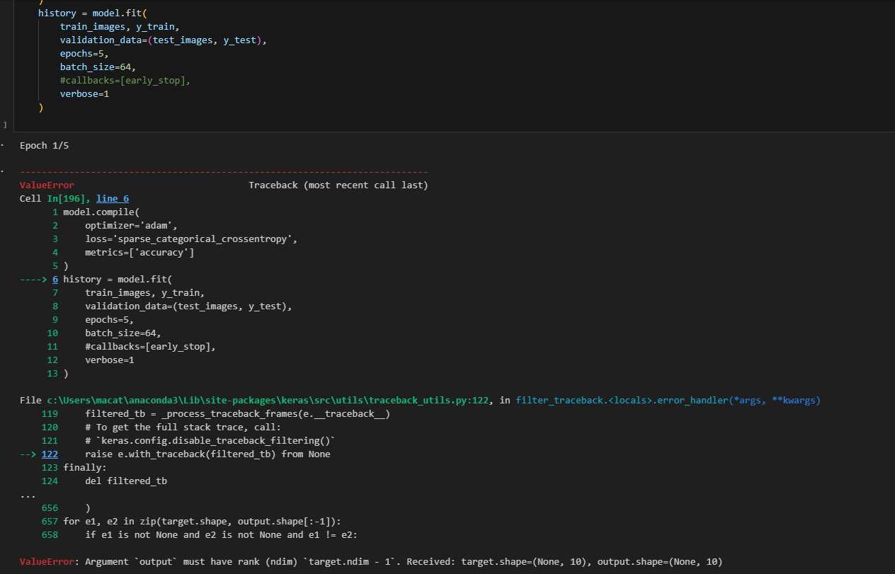
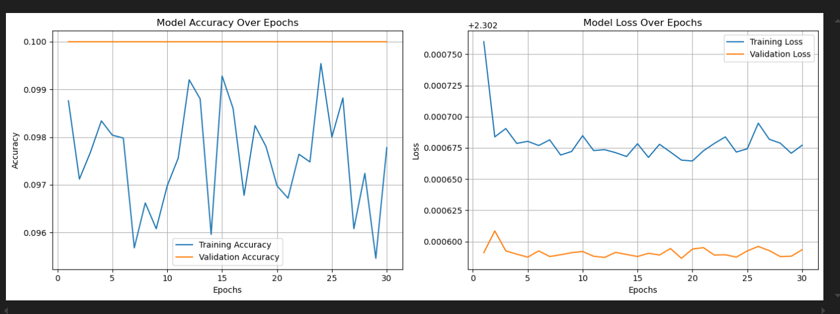
Challenges & learnings during MT
Errors & Discrepancies in the output
2. Loading Time = minimizing number of epoch

Slide 7
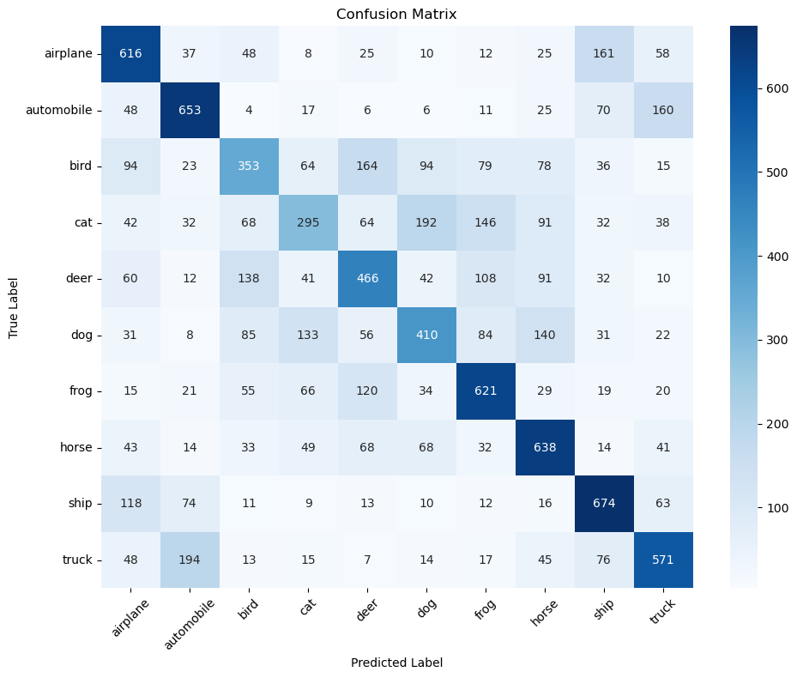
Model Evaluation
Steps Taken:
📥 Load the trained model
🔍 Predict on test data
Model achieves 52% accuracy on unseen data. Model is learning meaningful patterns.
High loss (1.31) modelis still not confident.
📊 Classification Report
Ship, automobile and airplane have good precision & recall – model distinguishes them well.
The model is mixing cats & dogs
Notes:
In the Model Evaluation the goal is to check if the model really learned to recognized images. 1) Loading the trained model:
2) Evaluating on Test data: Here is to test the model on unseen images. The model achieves 52% accuracy on unseen test data, which is actually great as we can see it´s learning. However, there is a relative high loss of (1.31), which tell us that the model is not super confident in many of it´s predictions. So definitely, there is a clear opportunity to improve accuracy, reduce error with more training data, data argumentation or deeper architecture.
3) Classification Report: Where we obtain the different columns of precision, recall, and F-1 score. Where it helped me understand where the model is strong and where was confused.
4) Generate the evaluation report based on the accuracy, precision, recall, F1 score and confusion matrix.

Slide 8
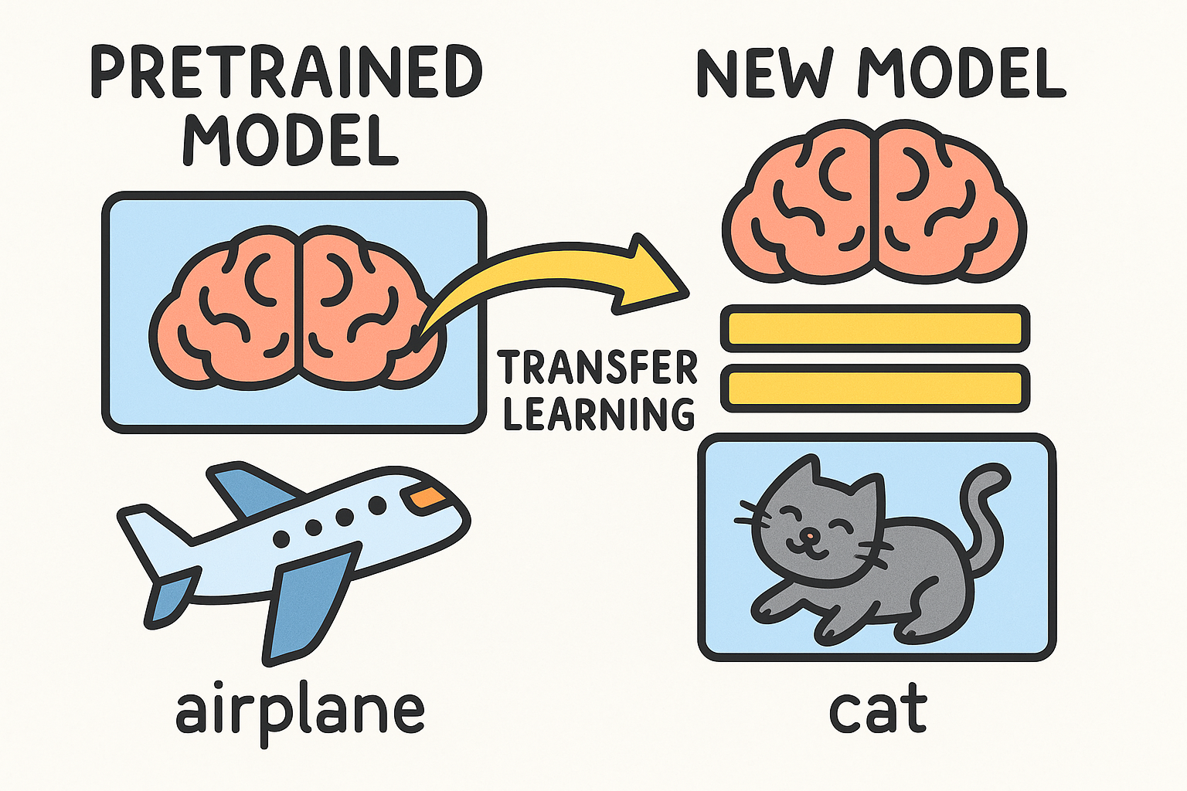
Transfer Learning
Steps Taken:
🧠 Load the pre-trained model and use feature extractor
VGG16
We also adjust image size to VGG16 (224 x 224)
✂️ Remove the top layer(s) of that model (which were made for a different task)
VGG16 requires specific image size (224 x 224)
🧱 Add new layers specific to CIFAR-10
🔒 Freeze the base model (so we don’t lose its pretrained knowledge)
🔄 Train only the top layers on CIFAR-10
📊 Evaluate accuracy like we did before
Notes:
So now that we have the model and already learned from millions of images, we move forward with Transfer learning, which is teaching the model how to solve problems without starting from scratch.
There were different models like ImagNet, VGG16, Inception. Did some research and the reason why I choose VGG16, because is simple on its architecture and easy to implement and visualized.

Slide 9
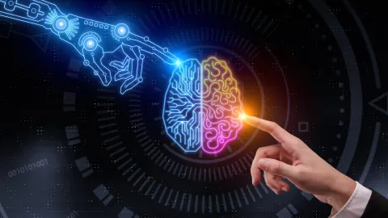
Conclusion & Learnings
✅ Successfully built an image classification model using CNN → Trained on the CIFAR-10 dataset with 10 object categories
📊 Achieved 52% test accuracy → Shows meaningful pattern recognition, with clear opportunities for improvement
🔍 Explored and understood key evaluation metrics → Used accuracy, precision, recall, F1 score, and confusion matrix to assess performance
🧹 Patience with loading time and errors → Proper image shaping, normalization, and labeling set the foundation for success.
🧑‍🏫 Gained hands-on experience with end-to-end AI pipeline → From loading and processing data to training, evaluation, and visualization
Notes:
🧹 Data Processing – Loading, reshaping, normalizing, and preparing the CIFAR-10 dataset.
🧠 Model Architecture Design – Building a CNN with convolution, pooling, and dense layers.
🏋️‍♂️ Model Training – Teaching the model to recognize patterns using labeled data.
📈 Model Evaluation – Testing on unseen data and analyzing metrics like accuracy, loss, precision, recall, etc.
🔁 Transfer Learning (optional step) – Leveraging pre-trained models to improve performance.
🧪 Result Interpretation & Visualization – Confusion matrix, classification report, and performance plots.

Slide 10
Thank you!

